Slide 1
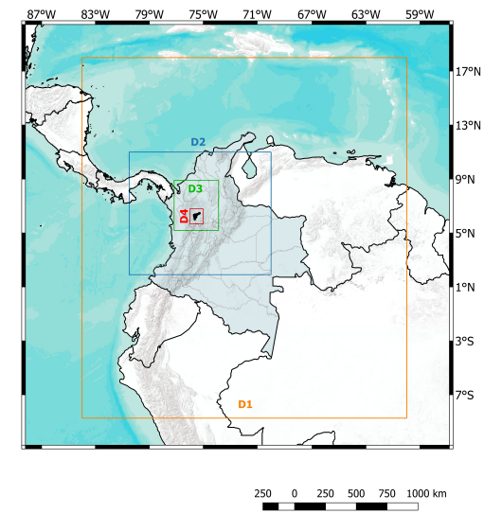
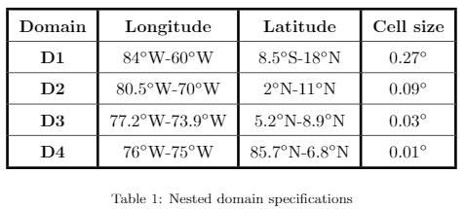
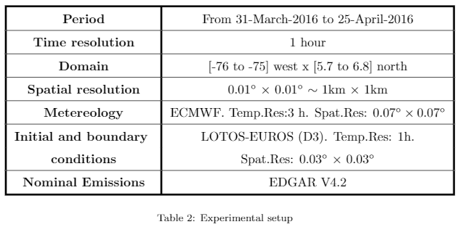

Ensemble Kalman Filter – PM over Aburrá Valley

Slide 2
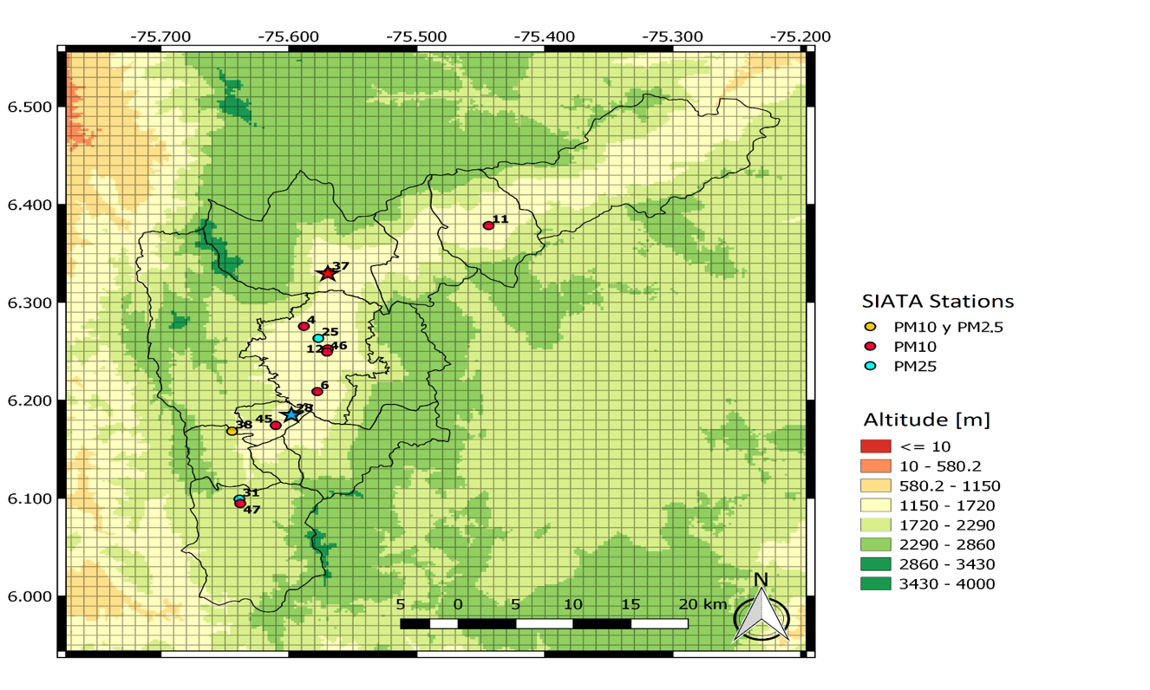
Ensemble Kalman Filter – PM over Aburrá Valley
Medellín Downtown

Slide 3
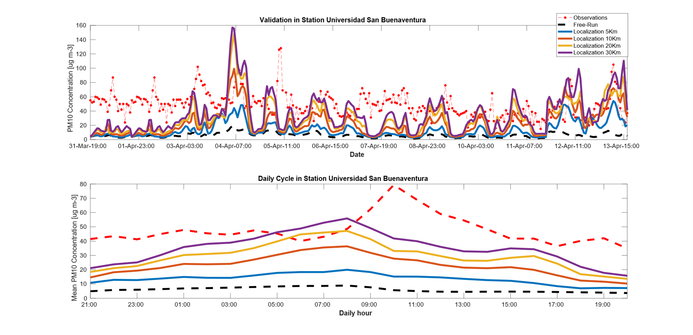
Preliminary Results

Slide 4
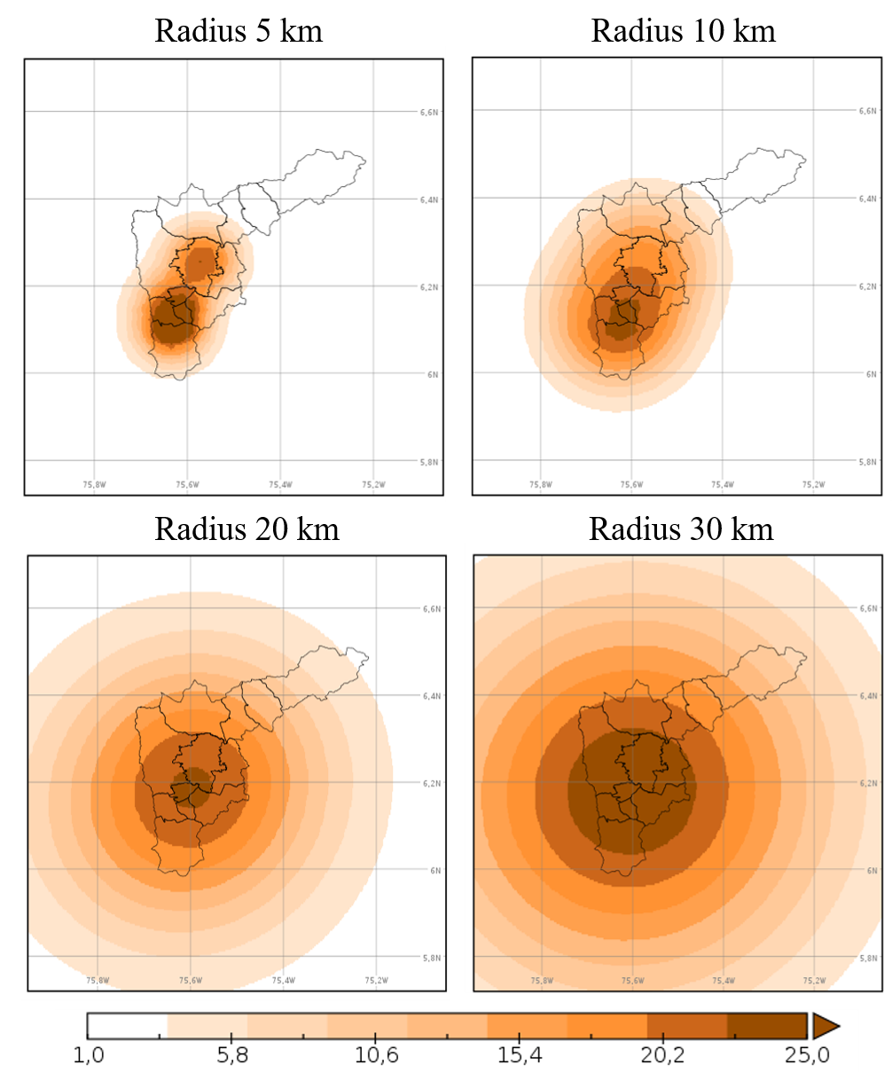
Preliminary Results

Slide 5
Ensemble Kalman Filter – PM over Aburrá Valley

Slide 6
Ensemble Kalman Filter – PM over Aburrá Valley

Slide 7
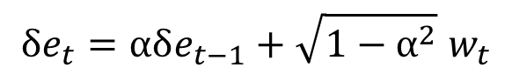
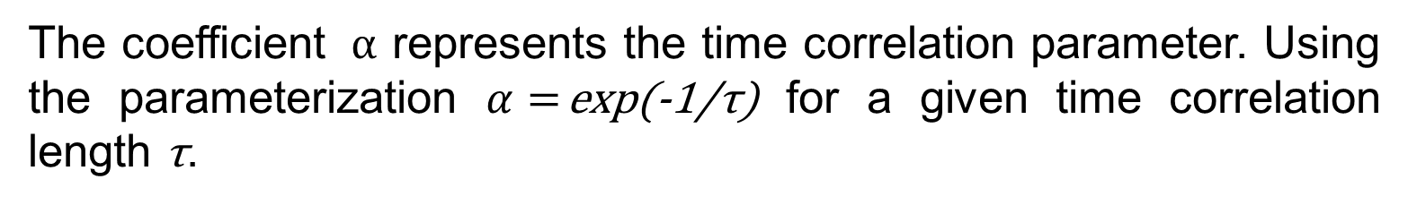
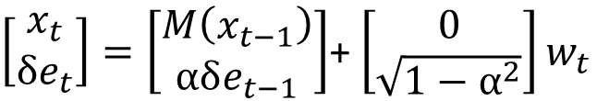
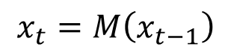
Ensemble Kalman Filter – PM over Aburrá Valley
We used a EnKF and a stochastic model for parameter estimation
$$x_{t}=M\left(x_{t−1}\right)$$
$$δe_{t}=αδe_{t−1}+\sqrt{1−α^{2}} w_{t}$$
$\left[\begin{matrix}x_{t} \\ δe_{t}\end{matrix}\right]=\left[\begin{matrix}M\left(x_{t−1}\right) \\ αδe_{t−1}\end{matrix}\right]$+ $\left[\begin{matrix}0 \\ \sqrt{1−α^{2}}\end{matrix}\right]w_{t}$
The coefficient $α$ represents the time correlation parameter. Using the parameterization $α=$exp(-1/τ) for a given time correlation length τ.
We are considering Uncertainties in:
PM10+BC Emissions
NH3 Emissions
SOx Emissions

Slide 8
Ensemble Kalman Filter – PM over Aburrá Valley

Slide 9
Ensemble Kalman Filter – PM over Aburrá Valley

Slide 10
Ensemble Kalman Filter – PM over Aburrá Valley

Slide 11
Ensemble Kalman Filter – PM over Aburrá Valley

Slide 12
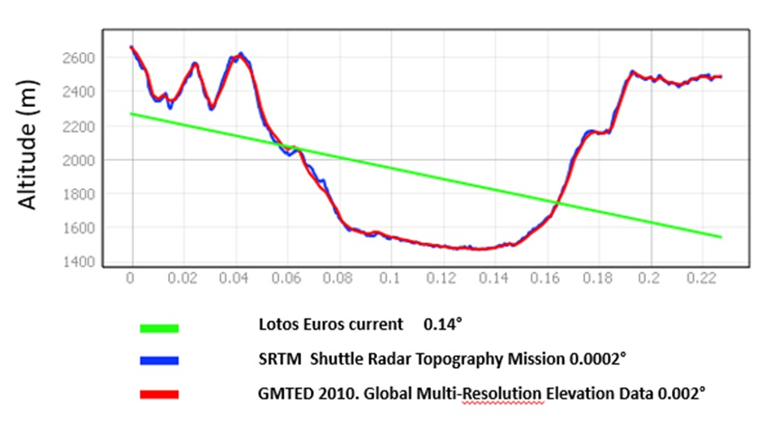

Slide 13
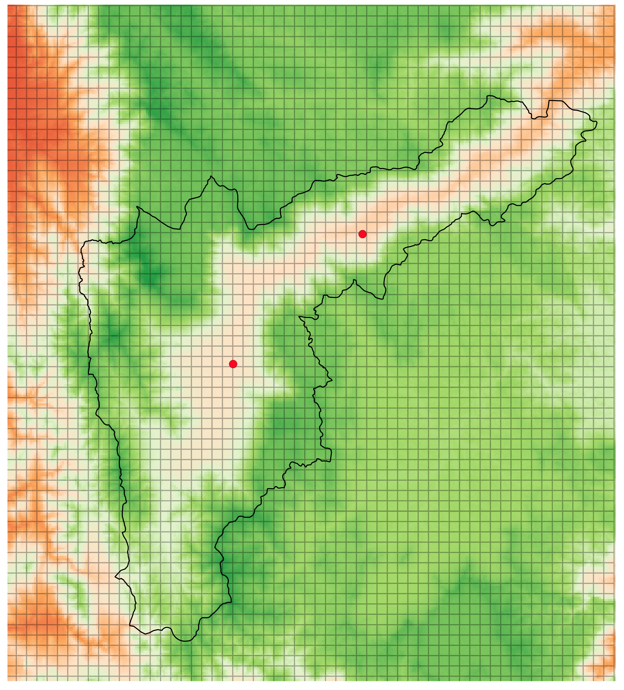

Slide 15
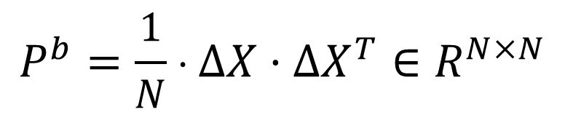
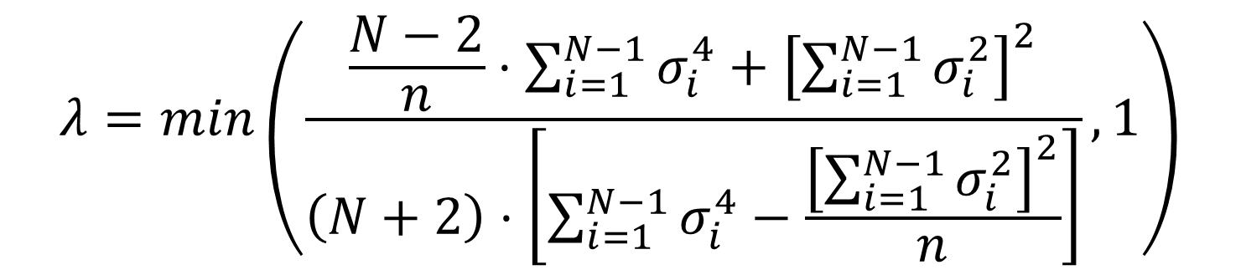
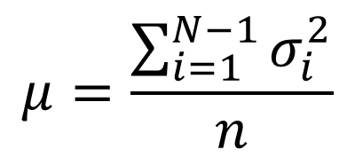
According with the works (Nino-Ruiz & Sandu, 2015; Nino-Ruiz & Sandu, 2017 ), using a Shrinkage estimator and the Ledoid and Wolf Method:
$$P^{b}=\frac{1}{N}⋅∆X⋅∆X^{T}∈R^{N×N}$$
$$\hat{B}=λ⋅μ⋅I+\left(1−λ\right)⋅P^{b}∈R^{N×N}$$
$$μ=\frac{\sum_{i=1}^{N−1}{σ_{i}^{2}}}{n}$$
$$λ=min\left(\frac{\frac{N−2}{n}⋅\sum_{i=1}^{N−1}{σ_{i}^{4}}+{\left[\sum_{i=1}^{N−1}{σ_{i}^{2}}\right]}^{2}}{\left(N+2\right)⋅\left[\sum_{i=1}^{N−1}{σ_{i}^{4}}−\frac{{\left[\sum_{i=1}^{N−1}{σ_{i}^{2}}\right]}^{2}}{n}\right]},1\right)$$

Slide 16
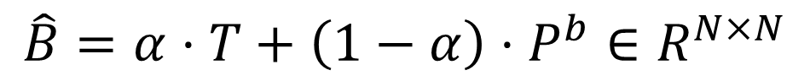
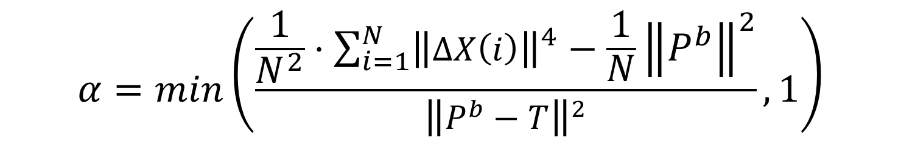
In (Stoica et. al., 2008) is proposed and extension of the Ledoid and Wolf method for a general Target Matrix (different to a Identity Matrix)
$$\hat{B}=α⋅T+\left(1−α\right)⋅P^{b}∈R^{N×N}$$
$$α=min\left(\frac{\frac{1}{N^{2}}⋅\sum_{i=1}^{N}{{\left\|∆X\left(i\right)\right\|}^{4}}−\frac{1}{N}{\left\|P^{b}\right\|}^{2}}{{\left\|P^{b}−T\right\|}^{2}},1\right)$$

Slide 17
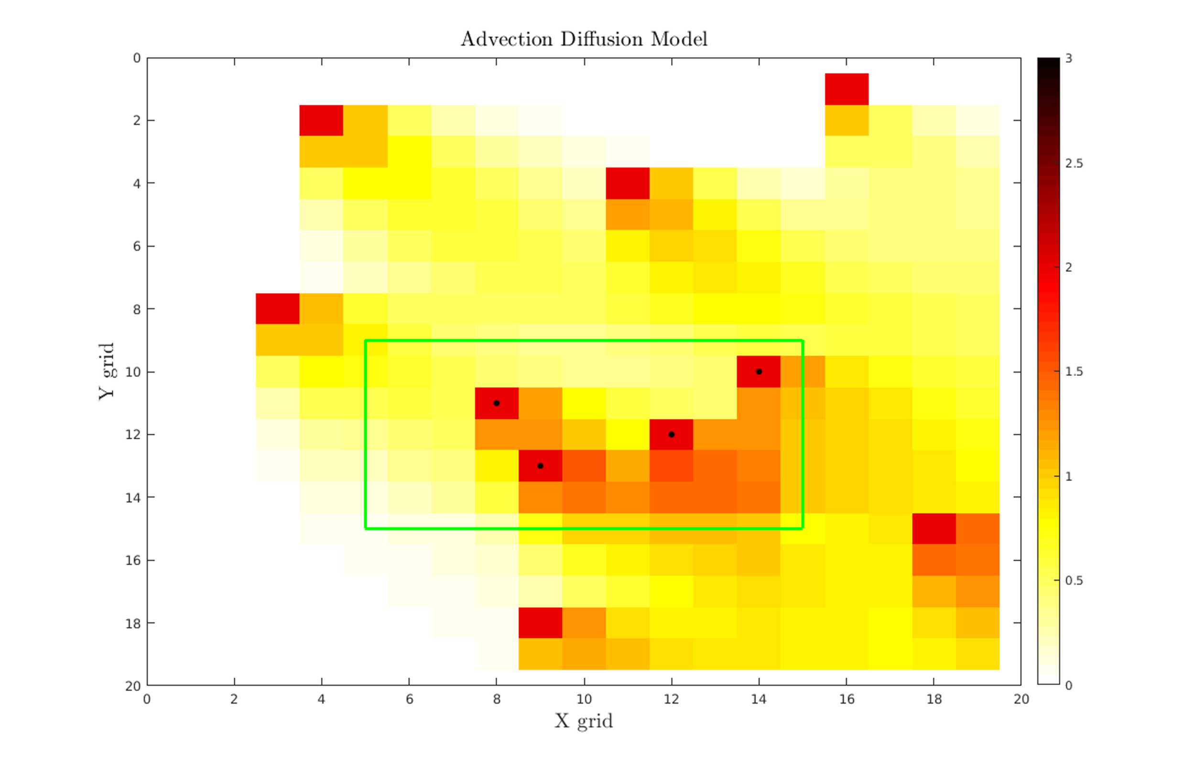
Reality

Slide 18
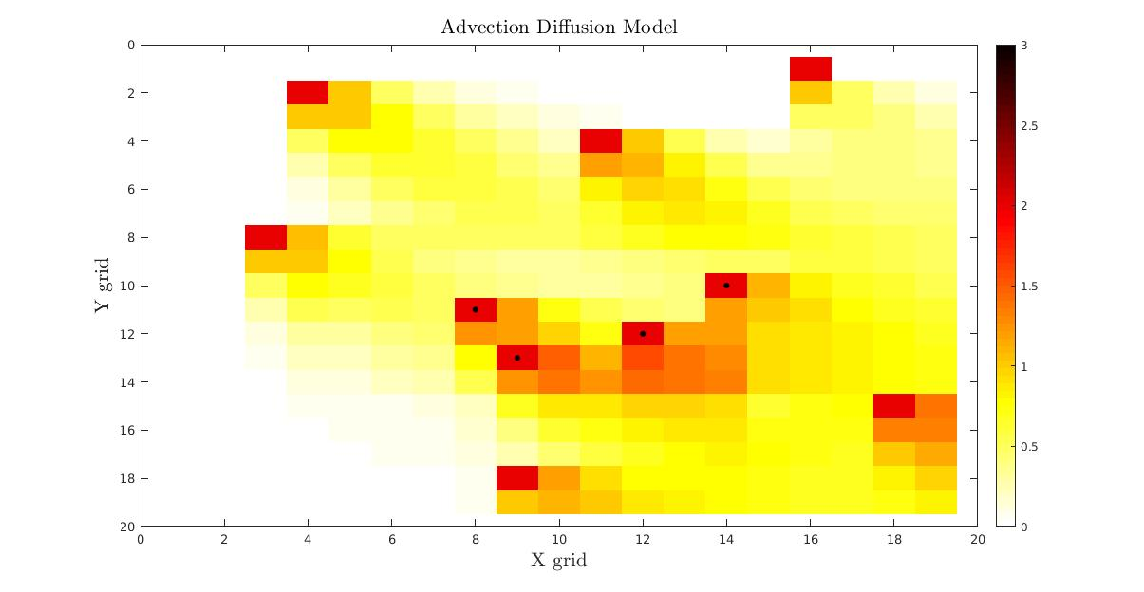
Model

Slide 19
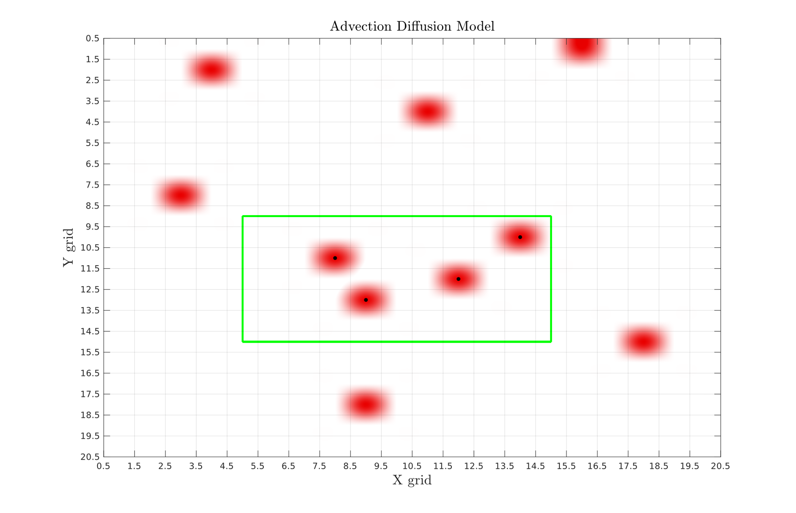

Slide 21
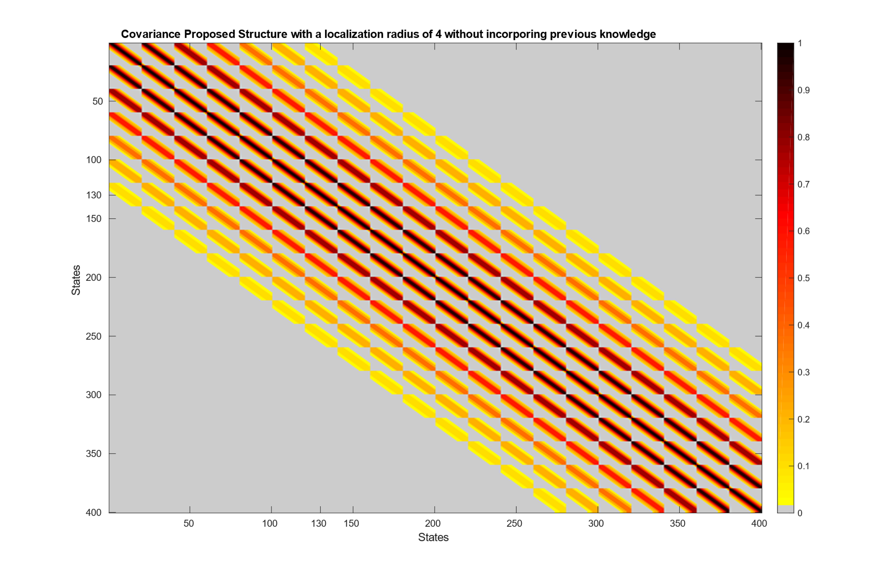

Slide 22
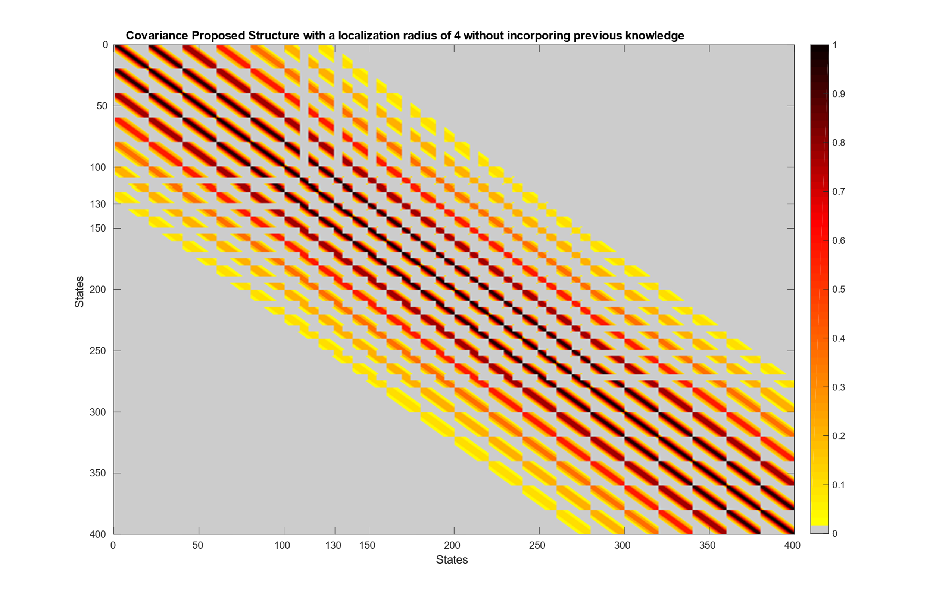

Slide 23
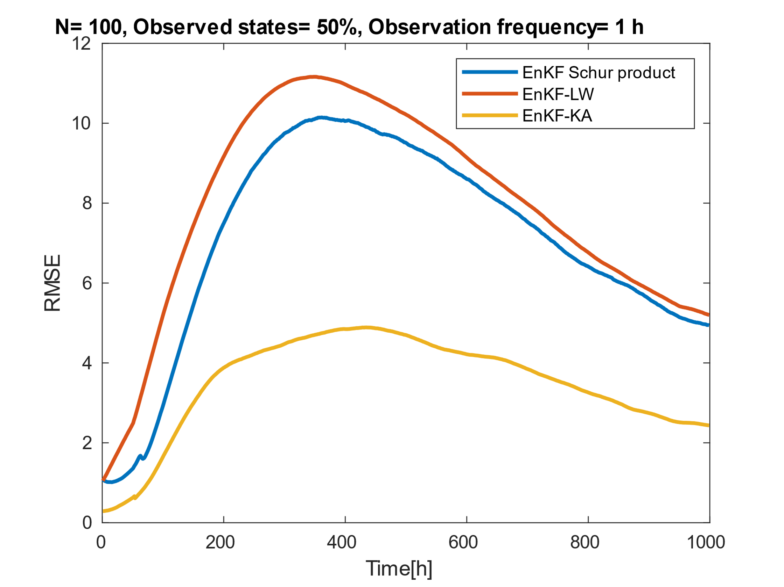
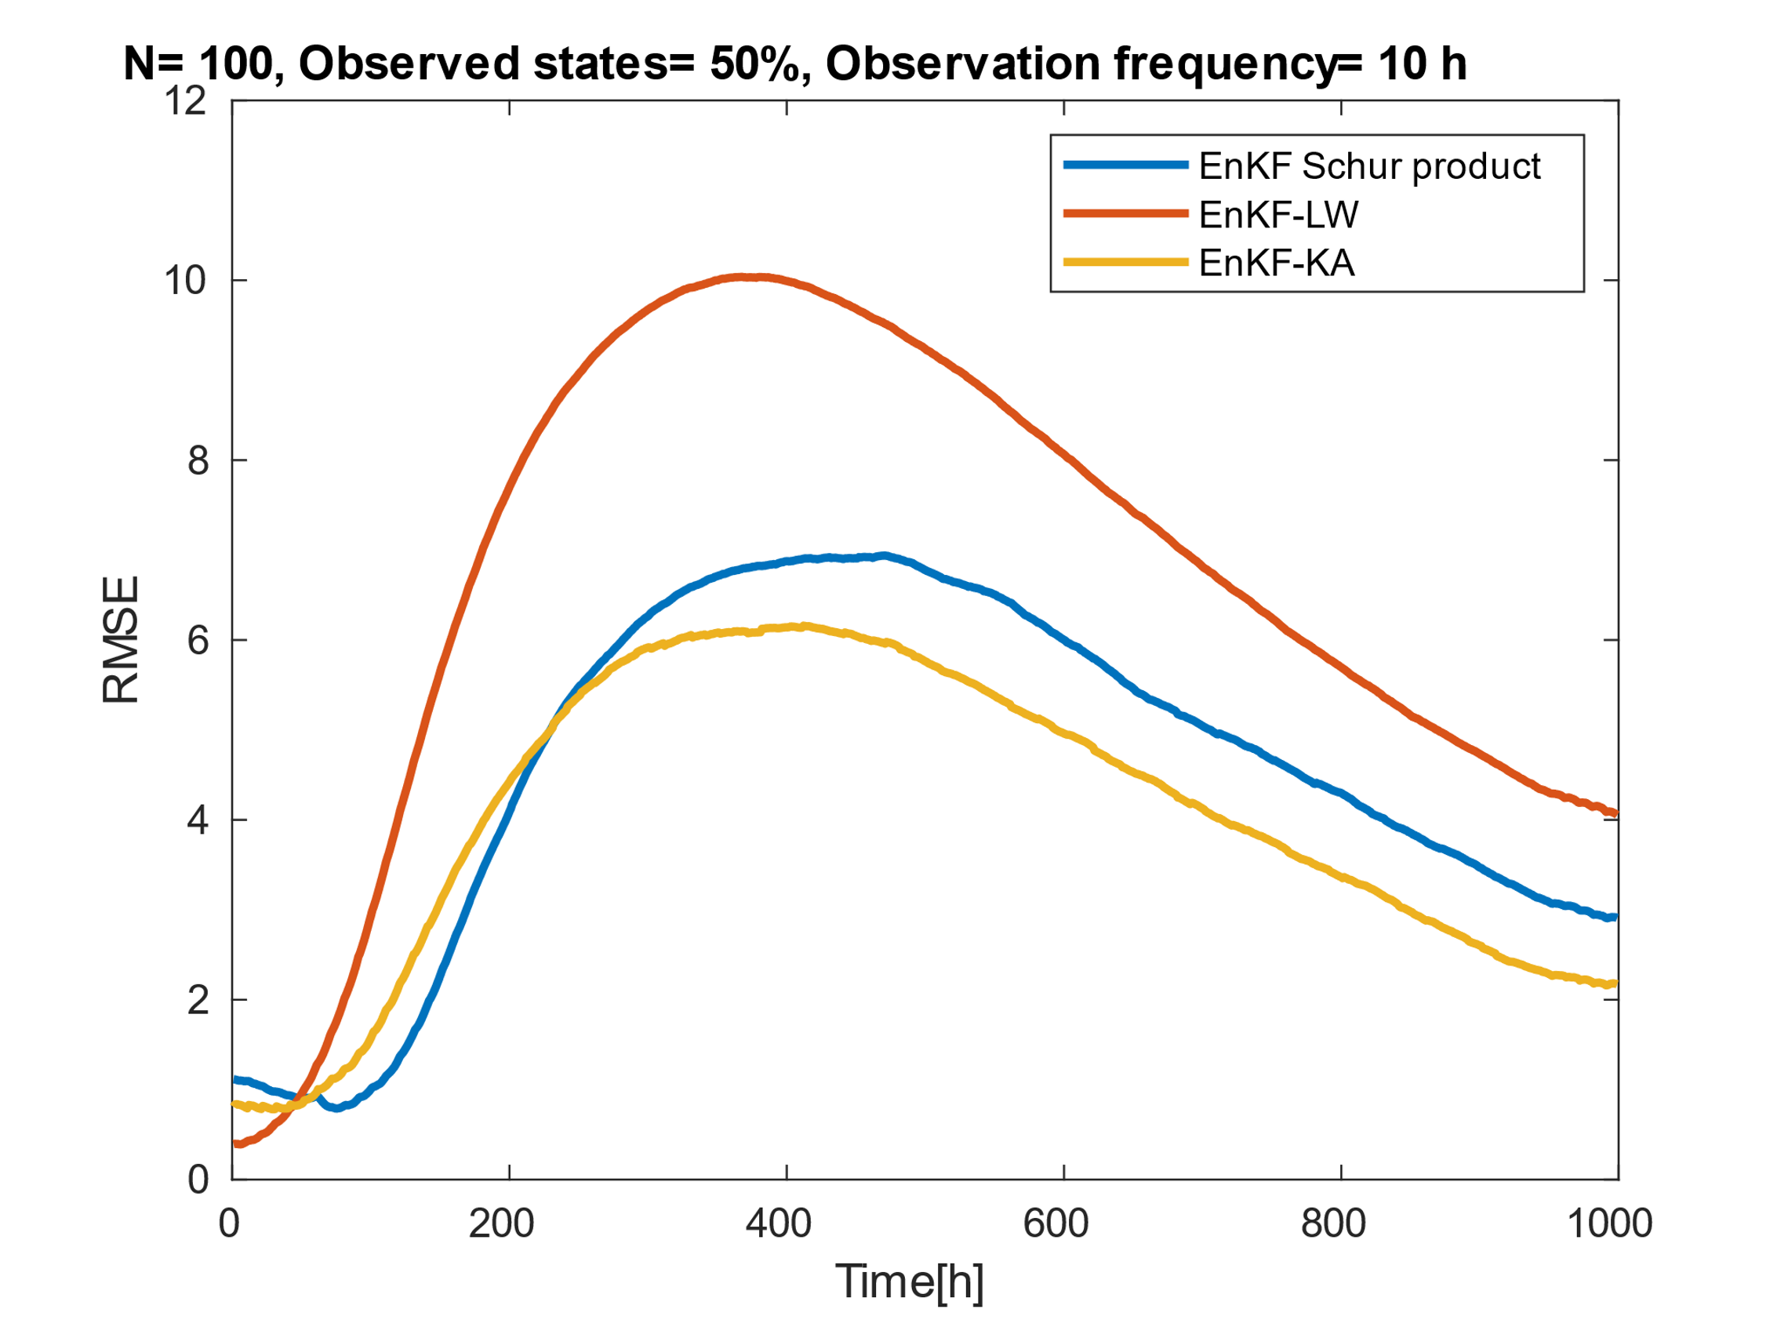

Slide 24
